Slide 1

Virtual, Augmented, and Mixed Reality
CS3009 Human Computer Interaction
Nadine Aburumman
"Virtual reality treadmill" by National Institutes of Health (NIH) is licensed under CC BY-NC 2.0
slides are based on materials created by Prof. Kate Hone
"Augmented Reality Anatomay" by NHS is licensed under CC BY 2.0

Slide 2

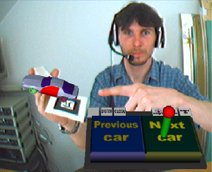
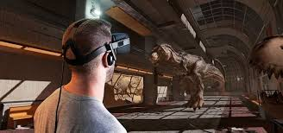
What is VR, AR, and MR?
From Real to Virtual
Mixed Reality (MR)
Real Environment
Augmented Reality (AR)
Virtual Reality
Virtual Environment
Milgram et al., " A Taxonomy of Mixed Reality Visual Displays”, 1994 IEICE Trans. Information Systems
Notes:
Mixed reality includes augmented reality, virtual reality, and other mixed configurations

Slide 3
Augmented Reality
K. Shokeen et al., “ARMath: Augmenting Everyday Life with Math Learning”, 2020 Conference on Human Factors in Computing Systems (CHI ‘20)
A. Jakl et al., "Enlightening Patients with Augmented Reality," 2020 IEEE Conference on Virtual Reality and 3D User Interfaces (VR)
Hobson et al., "Alpaca: AR Graphics Extensions for Web Applications," 2020 IEEE Conference on Virtual Reality and 3D User Interfaces (VR)
A combination of a real scene viewed by a user and a virtual scene generated by a computer that augments the scene with additional information
Notes:
Mixed reality includes augmented reality, virtual reality, and other mixed configurations

Slide 4
Virtual Reality
Hou et al., “Autonomous Vehicle-Cyclist Interaction: Peril and Promise” In Proceedings of the 2020 CHI Conference on Human Factors in Computing Systems (CHI ‘20)
Lin et al., “ARchitect: Building Interactive Virtual Experiences from Physical Affordances by Bringing Human-in-the-Loop”. In Proceedings of the 2020 CHI Conference on Human Factors in Computing Systems (CHI '20)
Nitsche et al., “Manipulating Puppets in VR” 2020 IEEE Conference on Virtual Reality and 3D User Interfaces (VR)
Headsets allow users to become deeply involved in the virtual world
Notes:
Mixed reality includes augmented reality, virtual reality, and other mixed configurations
See the real world whilst also seeing *believable* virtual objects

